Slide 1
Breast Cancer Wisconsin Dataset Visualization
Lavinia Fabrello
Sara Goldoni
Federica Savini

Slide 2
AGENDA
Mettere link con riferimento nella pagina o con numero
Differenza tumori benigni e maligni, cerchio e stella: ok
Parallel plot non normalizzato vs normalizzato
Matrice di correlazione mean
Jitter plot e box plot
Perimetro/2pi vs raggio
Paziente medio
Grafico con errore
Standard error spiegazione (con grafico accanto)
Backup delle varie prove (small multiple ecc.)

Slide 3
Sklearn - Breast Cancer Wisconsin Data Set
Number of Instances:
569
Number of Attributes:
30 numeric, predictive attributes and the class
Class:
WDBC-Malignant
WDBC-Benign
Missing Attribute Values:
None
Class Distribution:
212 - Malignant,
357 - Benign
Creator:
Dr. William H. Wolberg, W. Nick Street, Olvi L. Mangasarian
Donor:
Nick Street
Date:
November, 1995

Slide 4
Data Set Description
Features are computed from a digitized image of a fine needle aspirate (FNA) of a breast mass.
They describe characteristics of the cell nuclei present in the image.
Radius
Texture
Perimeter
Concavity
Smoothness
local variation in radius lengths
standard deviation of gray-scale values
mean of distances from center to points on the perimeter
severity of concave portions of the contour.
It’s the ratio between concave zone and perimeter.
Concave points
Symmetry
Fractal dimension
Number of concave portions of the contour
“coastline approximation” – 1. The fractal dimension of a system is a characteristic number associated to the geometric self-similarity pattern presented in the image structure.
Compactness
(Perimeter)² / area - 1.0
Is a measure of how evenly a particular chromatin component is distributed over the two-dimensional projection of the nuclear image
Area

Slide 5
Difference between malignant and benign tumor
Benign tumors are characterized by a well-defined shape. They resemble a circle and do not have the ability to create metastases.
Malignant tumors, on the other hand, form offshoots that entangle nearby normal cells and destroy them, they are made up of cells that appear morphologically and functionally different from the corresponding normal ones.

Slide 6
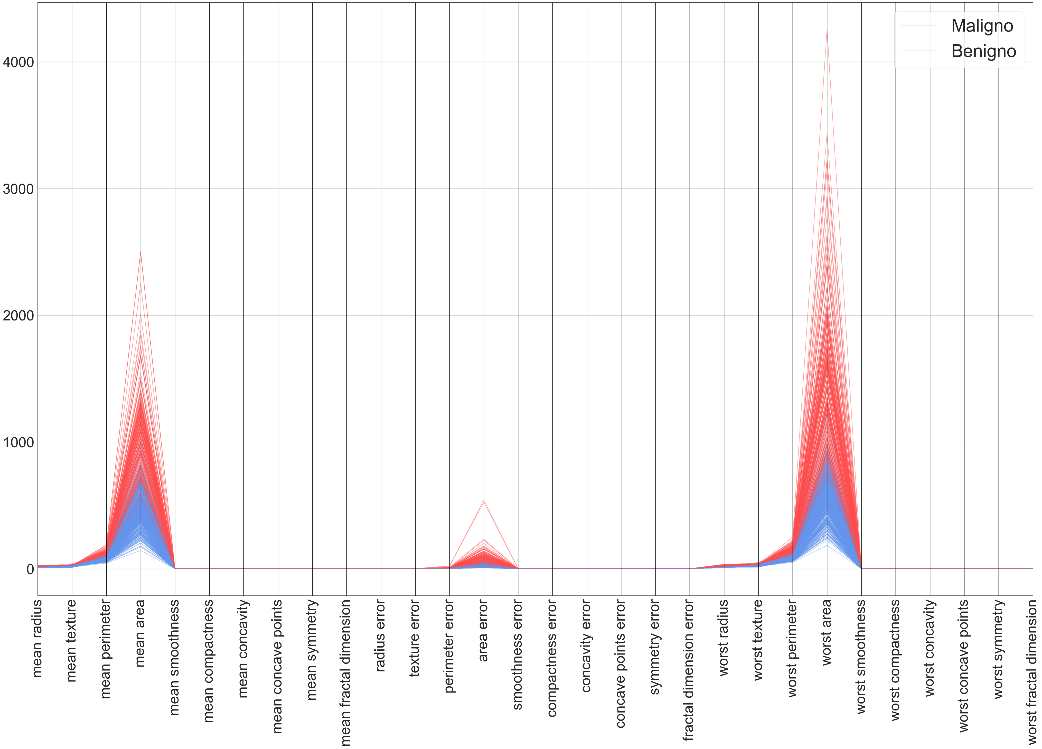
Parallel
Plot
To have a first look of the data distribution and relevance

Slide 7
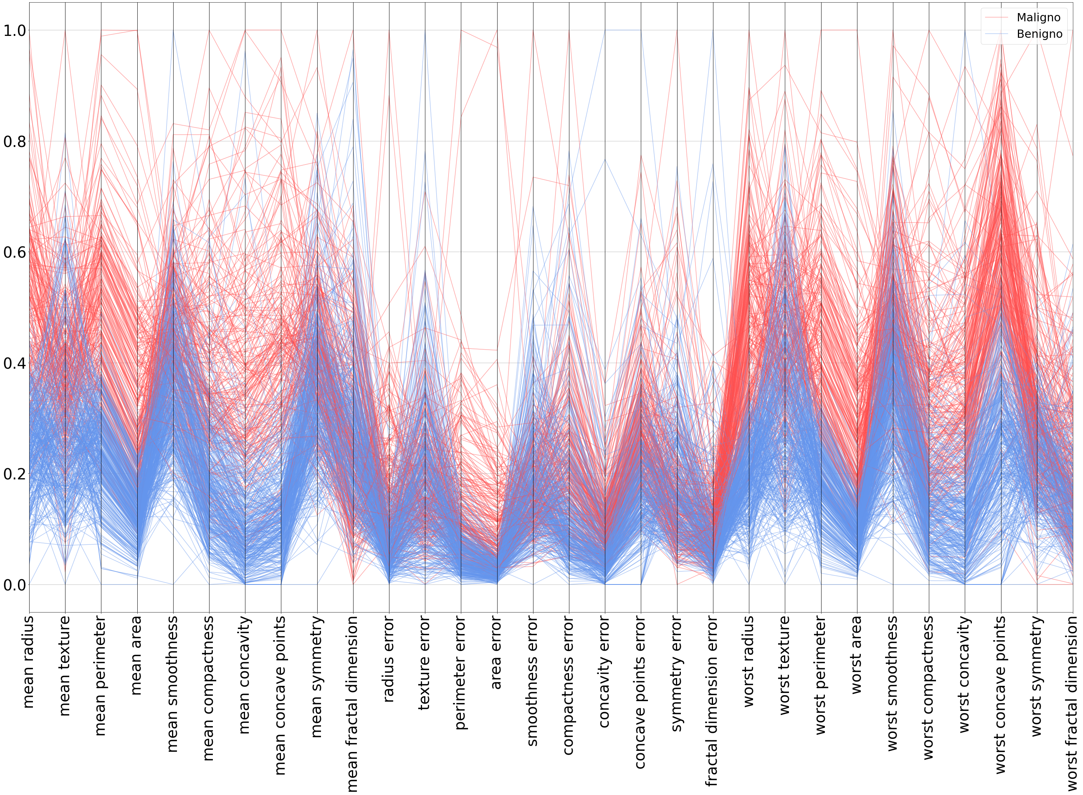
Normalized parallel plot
To see if there are any attributes that are more relevant than the others, but all of them are equally relevant.

Slide 8
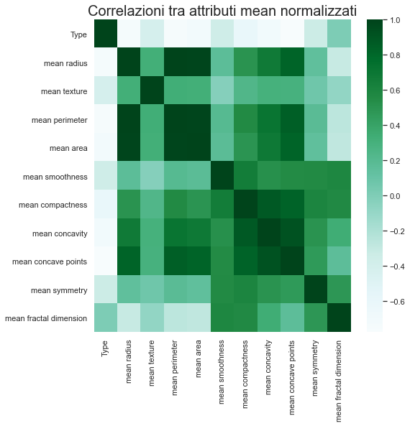
Correlation matrix
To visualize the correlation between features.

Slide 9
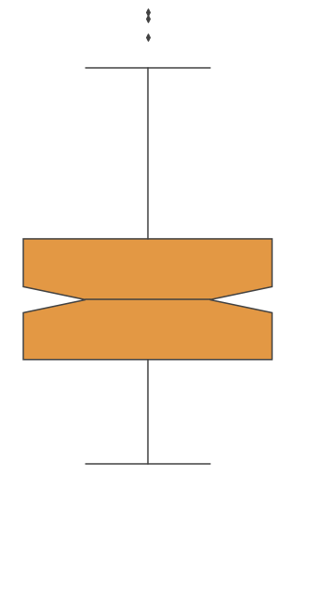
Upper Whiskers:
Maximum
Outliers
Third quartile
It’s the value that has 75% of the elements under itself and 25% over; it’s also called 75th percentile
Median
First quartile
It’s the value that has 25% of the elements of the distribution under itself; it’s also caleed 25-esimo percentile
Lower Whiskers:
Minimum
BOX PLOT

Slide 10
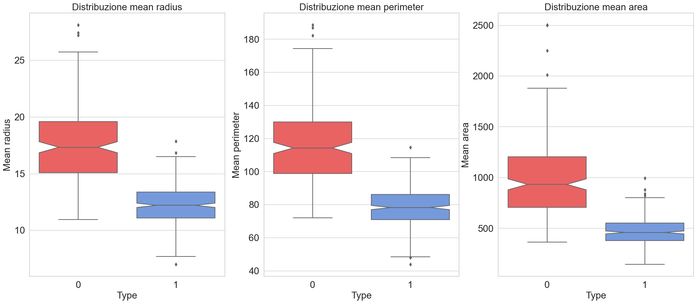
BOX PLOT
Maligni
Benigni

Slide 11
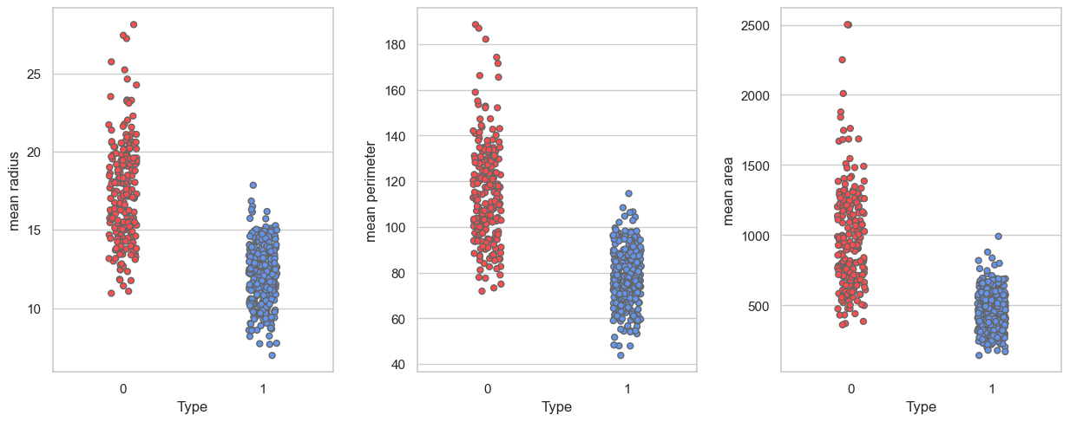
Strip Plot

Slide 12
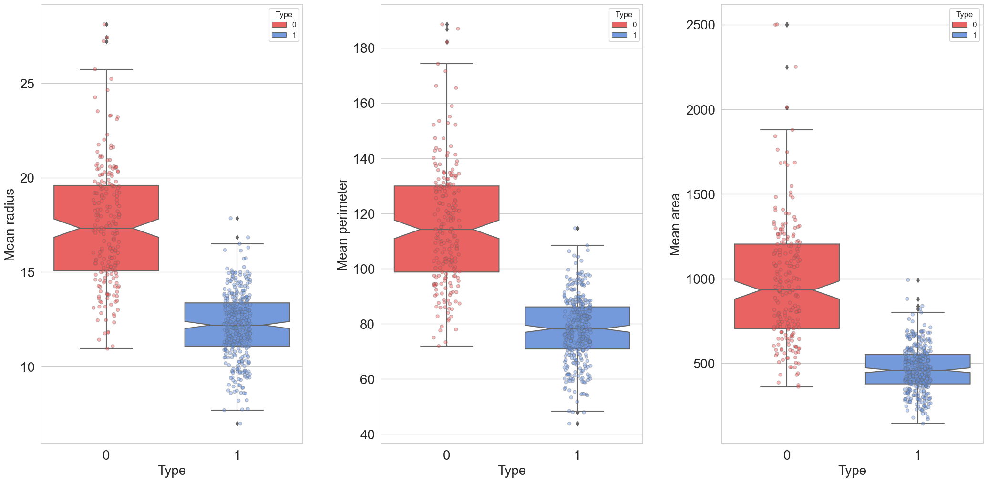
Comparison

Slide 13
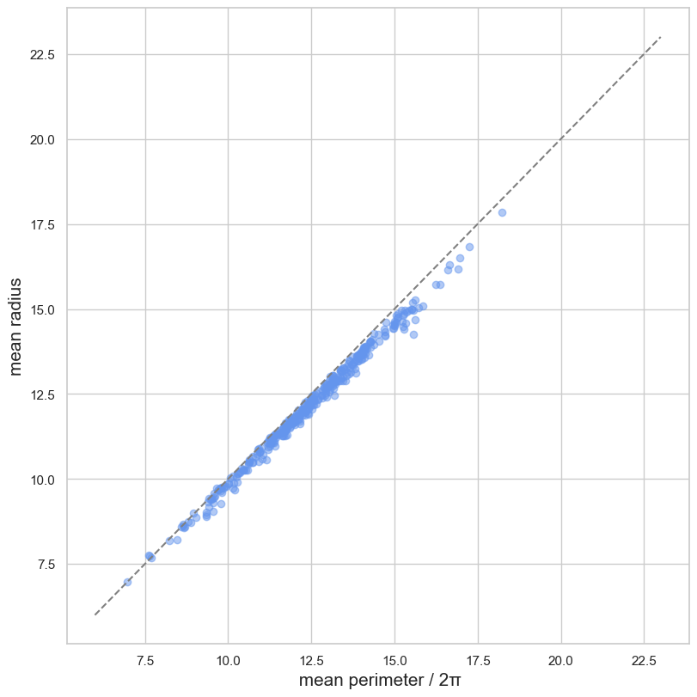
Mean radius vs (mean perimeter/2π)
We know that a benign cancer cell may look very different from malignant one. In generale, benign cancer cell look like a circle, malignant one instead resembles star.
Can we demonstrate this affermation looking at our dataset?

Slide 14
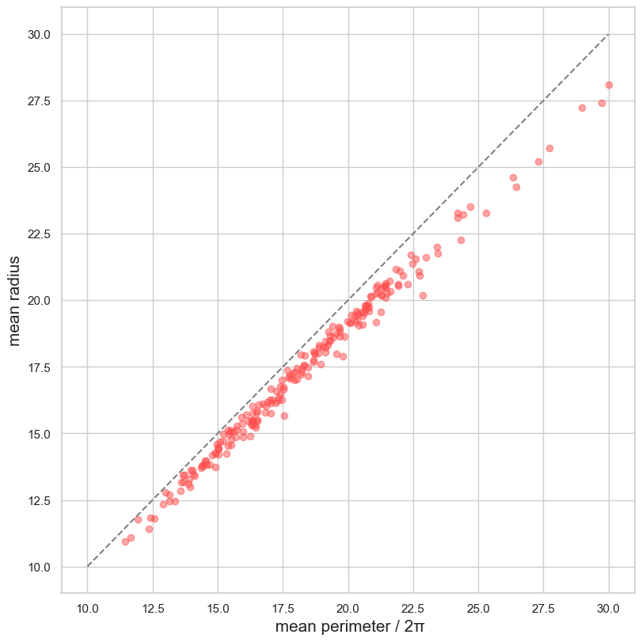
Malignant ones
We immediatly see that the patients distribution is under the bisector as a proof that malignant cancer cells has a different shape than a circle.

Slide 15
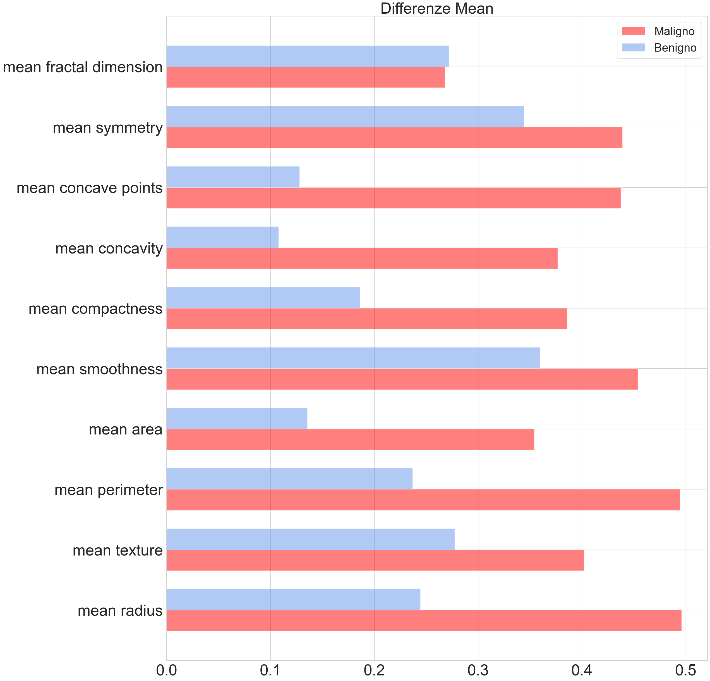
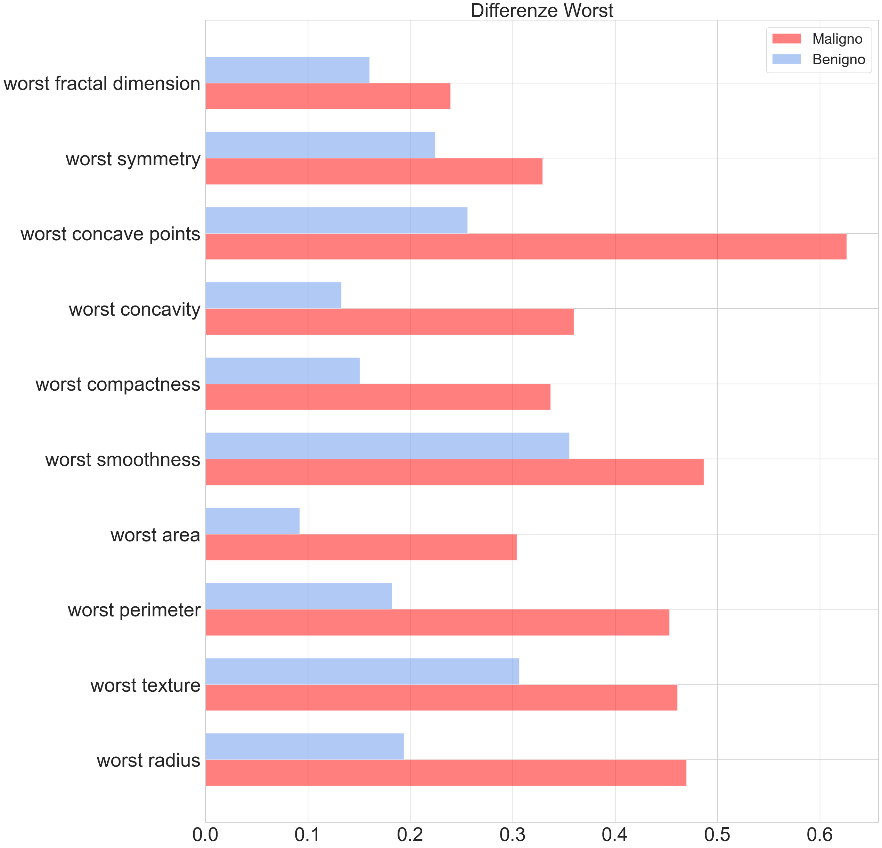
Paziente medio benigno e maligno

Slide 16
Standard error
Formule e spiegazione

Slide 17
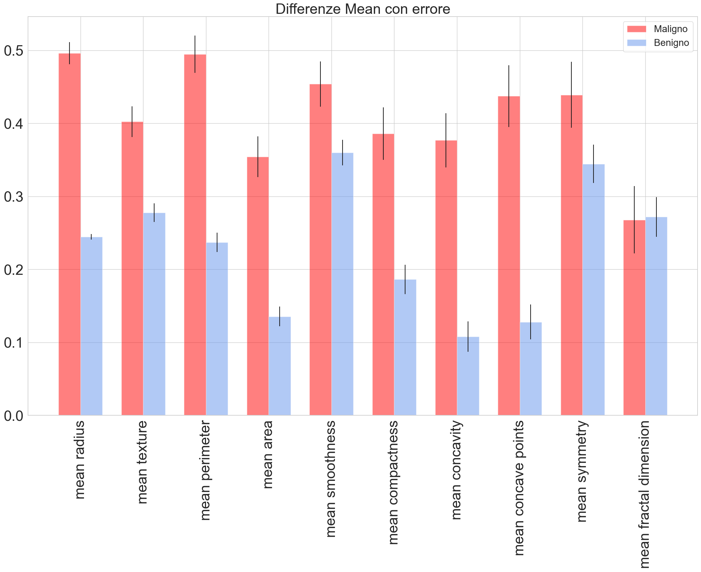
Standard Error Plot
The black bar is the error
Aggiungere spiegazione breve a piacere

Slide 24
Mean radius vs (mean perimeter/2π)
We know that a benign cancer cell may look very different from a malignant one. In generale, benign cancer cell look like a circle, malignant one instead resembles star. Can we demonstrate this affermation looking at our dataset?
If we think at a circle we know that perimeter is 2πr where r is the radius, if we divide this by 2π we have r that, considering that benign cancer cells are like a circle, must be almost the same and the bisector will appear in the plot. If that doesn’t occur it means that the mean radius of our dataset and mean perimeter/ 2π are quite different and one of them is greater than the other. This let us at the conclousion that if the distribution of our data is under the bisector then we are looking at malignant tumor cells.

